Slide 1

Billing Process Algorithm
Presented by –
Harsh Gulati
Vikas Parwani
Prince Jain
Sambhav Jain

Slide 2

Welcome to BCA Honours Juice Waale

Slide 3
Table of contents
Introduction
Motivation
Work Done
Conclusion

Slide 4
Introduction
To give you all a brief idea of what are we upto is, we opened a juice corner and emphasized on its billing algorithm, from drinks selection to the final price that a customer has to pay.
Want to know how ? Come let’s understand it step by step…

Slide 5
Work Done
In this presentation our prime focus is on the billing process of a juice shop.
We are going to display a menu in front of customers and they may choose what they are willing to drink. The prices displayed are exclusive of GST and the final prices(inclusive of 12% GST) will be communicated to them at the time of billing, we also offer 10% discount on Sundays for everyone.
Our menu contains different types of juices, shakes, lassi and cold coffee, from which a customer may choose.

Slide 6
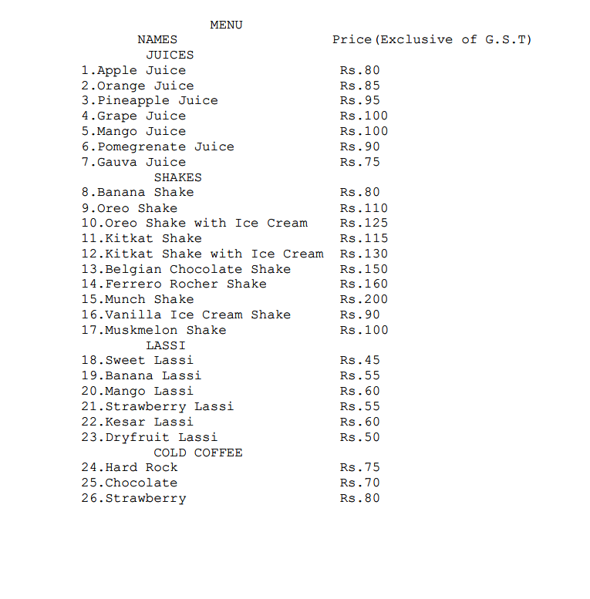


Slide 7

Conclusion
At last we would like to conclude and show you the program which we made and after that you all will be free to ask questions from us, and we will try to answer your questions. We have tried our best to show you the billing process of a juice corner from, a customer orders a drink to the final price he has to pay, we also offer a special discount every Sunday.
We have put in a lot efforts in making this presentation and have made the code as simple as possible for everybody to understand, I hope we were clear about what we tried to explain.

Slide 8

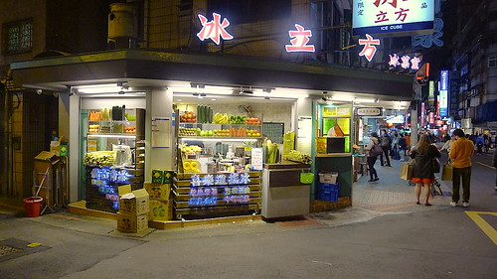

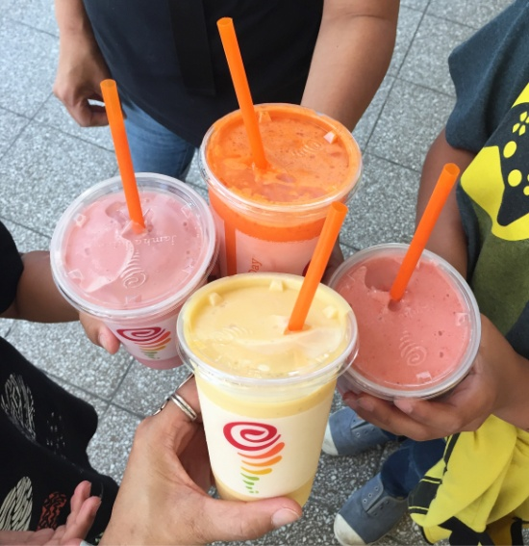
THANK YOU

Slide 9
Any Questions ?
Now if you have any questions, our answer panel, i.e, Prince Jain and Sambhav Jain are all set to answer your questions.
You may start one by one…

